Slide 1
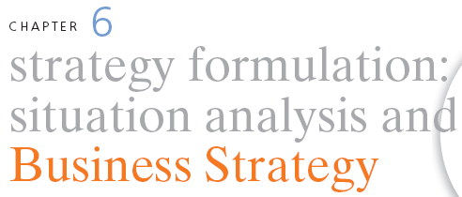
STRATEGIC MANAGEMENT & BUSINESS POLICY
13TH EDITION
THOMAS L. WHEELEN J. DAVID HUNGER

Slide 2

“
The biggest risk is not taking any risk…in a world that’s changing really quickly, the only strategy that is guaranteed to fail is not taking risks
”
Mark Zukerberg
Founder & CEO
Facebook

Slide 3

Strategy formulation - concerns developing a corporation’s mission, objectives, strategies and policies
Situation Analysis - the process of finding a strategic fit between external opportunities and internal strengths while working around external and internal weaknesses

Slide 4
SWOT- Strengths-Weaknesses-Opportunities-Threats
Strategy= opportunity/capacity
Opportunity has no real value unless a company has the capacity to take advantage of that opportunity

Slide 5
Criticisms of SWOT analysis
Generates lengthy lists
Uses no weights to reflect priorities
Uses ambiguous words and phrases
Same factor can be in 2 categories
No obligation to verify opinion with data or analysis
Requires only a single level of analysis
No logical link to strategy implementation

Slide 6
Generating a Strategic Factors Analysis Summary (SFAS) Matrix
SFAS summarizes an organization’s strategic factors by combining the external factors from the EFAS Table with the internal factors from the IFAS Table

Slide 7
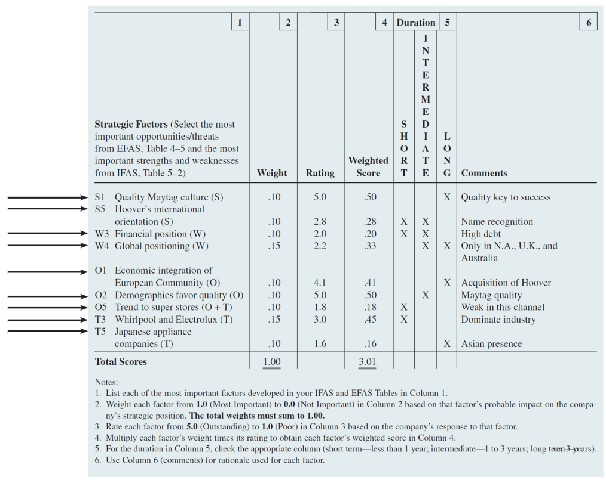
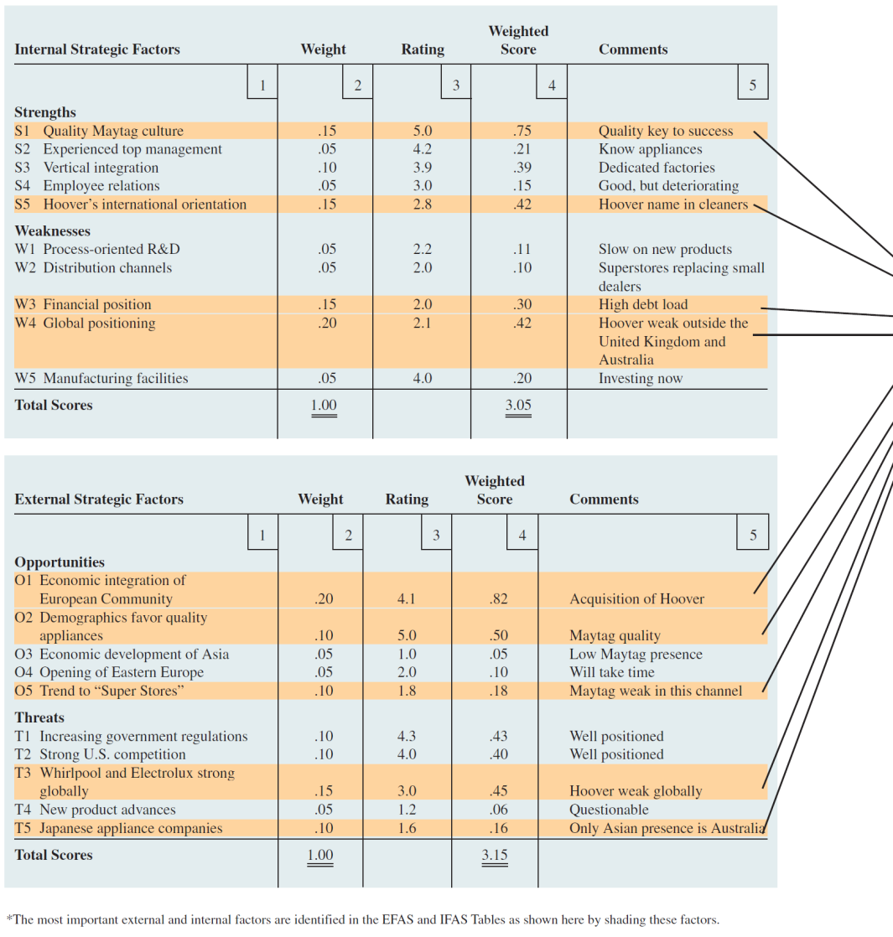

Slide 8
Finding a Propitious Niche
Propitious niche- where an organization can use its core competencies to take advantage of a particular market opportunity and the niche is just large enough for one firm to satisfy its demand
Strategic sweet spot- a company is able to satisfy customers’ needs in a way that rivals cannot
Strategic window- a unique market opportunity that is available for a particular time

Slide 9
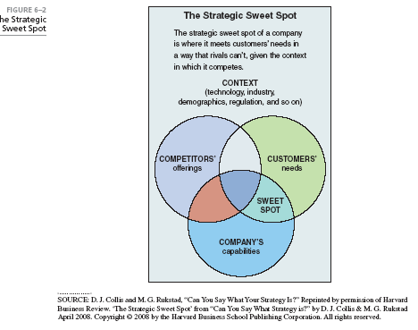

Slide 10

Review of Mission and Objectives
A re-examination of an organization’s current mission and objectives must be made before alternative strategies can be generated and evaluated
Performance problems can derive from inappropriate (narrow or too broad) mission statements and objectives

Slide 11

TOWS Matrix- illustrates how the external opportunities and threats can be matched with internal strengths and weaknesses to result in 4 possible strategic alternatives
Match the elements of S & W with the O & T to generate action steps
Provides a means to brainstorm alternative strategies
Forces managers to create various kinds of growth and retrenchment strategies
Used to generate corporate as well as business strategies

Slide 12
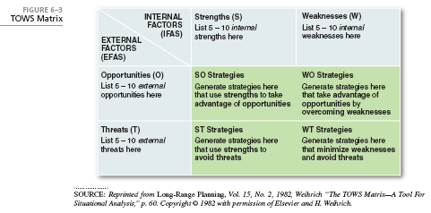

Slide 13
Generating a Plan of Action
Take care in entering items in the S, W, O, and T boxes, for they determine the quality of action steps you will generate. Try to be as specific as you can.
When you match the items to generate action steps, state it as actions the organization can undertake, rather than as an analysis of the situation. Matching the strengths and opportunities directs the growth and expansion of firms.
Equally important is the intersection of weaknesses and threats. They represent areas where the organization is particularly vulnerable, especially in a very competitive environment. Steps the organization could take to mitigate potential threats and strengthen its position are important components of an action plan.
Notes:
Take care in entering items in the S, W, O, and T boxes, for they determine the quality of action steps you will generate. Try to be as specific as you can. For instance, rather than saying “Good marketing skills,” it is better to specify what aspect of marketing a company can do well. Or, instead of listing “International expansion” as an opportunity, try to spell out what market characteristic, internationally, represents the opportunity. When you match the items to generate action steps, state it as actions the organization can undertake, rather than as an analysis of the situation. Matching the strengths and opportunities directs the growth and expansion of firms. However, equally important is the intersection of weaknesses and threats. They represent areas where the organization is particularly vulnerable, especially in a very competitive environment. Steps the organization could take to mitigate potential threats and strengthen its position are important components of an action plan.
Complementary action steps, from the various boxes, can be combined to form a cohesive “alternative.” When at least two such alternative groups of action steps are formed, they present alternative plans of action for the future. Then, depending on goals, resource availability, short vs. long-term time frame, etc., the organization can make a choice.

Slide 14
Common Errors of Applying the TOWS
A common mistake is to confuse a weakness with a threat. (e.g. an item belongs to the “Threats” category because it deals with a trend that is external to the firm).
When an item is included, it should be spelled out so that it is clear why it is considered a strength or a threat. (e.g. if just the word “Size” were written in one of the boxes, it would be confusing, particularly since size can be both a “Strength” and “Weakness”).
The action step should be worded in a manner that leads to action, not a comment or a statement.
Writing the source of the action step within parenthesis (such as W1, T2, etc) is a way to check at the end whether all the items of S, W, O, T have been used and also to subsequently back-track to see how a step was arrived at.

Slide 15
Enhanced SWOT Analysis
 | Strengths | Weaknesses
Opportunities | How do I use these strengths to take advantage of these opportunities? | How do I overcome the weaknesses that prevent me taking advantage of these opportunities?
Threats | How do I use these strengths to reduce the likelihood and impact of these threats? | How do I address the weaknesses that will make these threats a reality?

Slide 16
TOWS Analysis: Subject
 |  | Internal
 |  | Strengths | Weaknesses
External | Opportunities | Strengths - Opportunities | Weaknesses - Opportunities
 | Threats | Strengths - Threats | Weaknesses -Threats

Slide 17
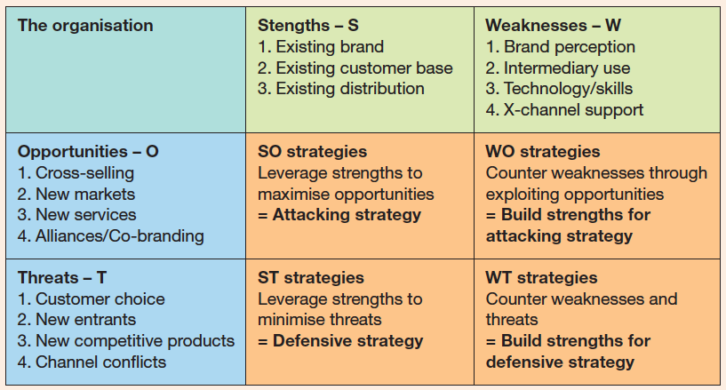

Slide 18

Business strategy focuses on improving the competitive position of a company’s or business unit’s products or services within the specific industry or market segment it serves

Slide 19
Business strategy is comprised of:
Competitive strategy (Battling against all competitors for advantage)
Cooperative strategy (Working with one or more companies to gain advantage against other competitors).

Slide 20
Porter’s competitive strategies
Lower cost strategy: the ability of a company or a business unit to design, produce and market a comparable product more efficiently than its competitors
Differentiation strategy: the ability of a company or a business unit to provide a unique or superior value to the buyer in terms of product quality, special features, or after sale service

Slide 21
Porter’s competitive strategies
Cost leadership a lower-cost competitive strategy that aims at the broad mass market and requires efficient scale facilities, cost reductions, cost and overhead control; avoids marginal customers, cost minimization in R&D, service, sales force and advertising
Provides a defense against competitors
Provides a barrier to entry
Generates increased market share

Slide 22
Porter’s competitive strategies
Differentiation involves the creation of a product or service that is perceived throughout the industry as unique. Can be associated with design, brand image, technology, features, dealer network, or customer service
Lowers customers sensitivity to price
Increases buyer loyalty
Barrier to entry
Can generate higher profits

Slide 23
Porter’s competitive strategies
Cost Focus: low-cost competitive strategy that focuses on a particular buyer group or geographic market and attempts to serve only this niche to the exclusion of others
Differentiation Focus: concentrates on a particular buyer group, product line segment, or geographic market to serve the needs of a narrow strategic market more effectively than its competitors

Slide 24
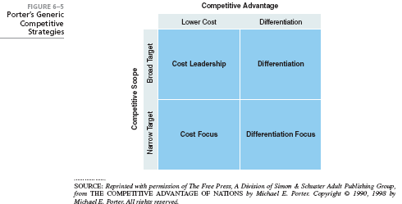

Slide 25
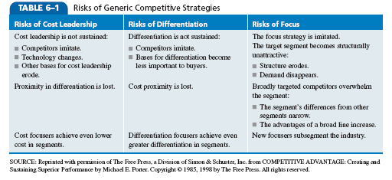
Risks in Competitive Strategies

Slide 26
Issues in Competitive Strategies
Stuck in the middle: when a company has no competitive advantage and is doomed to below-average performance

Slide 27
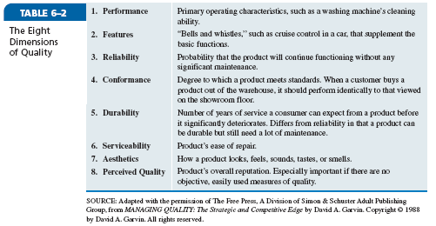

Slide 28
Industry Structure and Competitive Strategy
Fragmented industry: many small- and medium-sized companies compete for relatively small shares of the total market
Products are typically in early stages of product life cycle
Focus strategies are used

Slide 29
Industry Structure and Competitive Strategy
Consolidated industry: domination by a few large companies
Emphasis on cost and service
Economies of scale
Regional and national brands
Slower growth over capacity
Knowledgeable buyers

Slide 30
Competitive Tactics
Tactic: a specific operating plan that details how a strategy is going to be implemented in terms of when and where it is to be put into action
Narrower in scope and shorter in time horizon than strategies

Slide 31
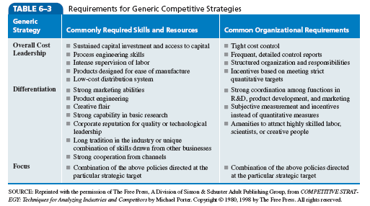

Slide 32
Timing Tactics: When to Compete
Timing Tactics- when a company implements a strategy
First movers
Late movers

Slide 33
Cooperative Strategies: used to gain a competitive advantage within an industry by working with other firms
Collusion: the active cooperation of firms within an industry to reduce output and raise prices to avoid economic law of supply and demand

Slide 34
Strategic Alliances: a long-term cooperative arrangement between two or more independent firms or business units that engage in business activities for mutual economic gain
Used to:
Obtain or learn new capabilities
Obtain access to specific markets
Reduce financial risk
Reduce political risk

Slide 35
Types of Cooperative Agreements
Mutual Service Consortia
Joint Venture
Licensing Arrangements
Value-Chain Partnerships

Slide 36

What industry forces might cause a propitious niche
to disappear?
Is it possible for a company or business unit to follow
a cost leadership and a differentiation strategy
simultaneously? Why or why not?
Is it possible for a company to have a sustainable competitive
advantage when its industry becomes hyper-competitive?
What are the advantages and disadvantages of being a
first mover in an industry? Give some examples
of first movers and late mover firms.
Why are strategic alliances temporary?

Slide 37

All rights reserved. No part of this publication may be reproduced, stored in a retrieval system, or transmitted, in any form or by any means, electronic, mechanical, photocopying, recording, or otherwise, without the prior written permission of the publisher. Printed in the United States of America.
Copyright ©2012 Pearson Education, Inc. publishing as Prentice Hall

